Slide 1

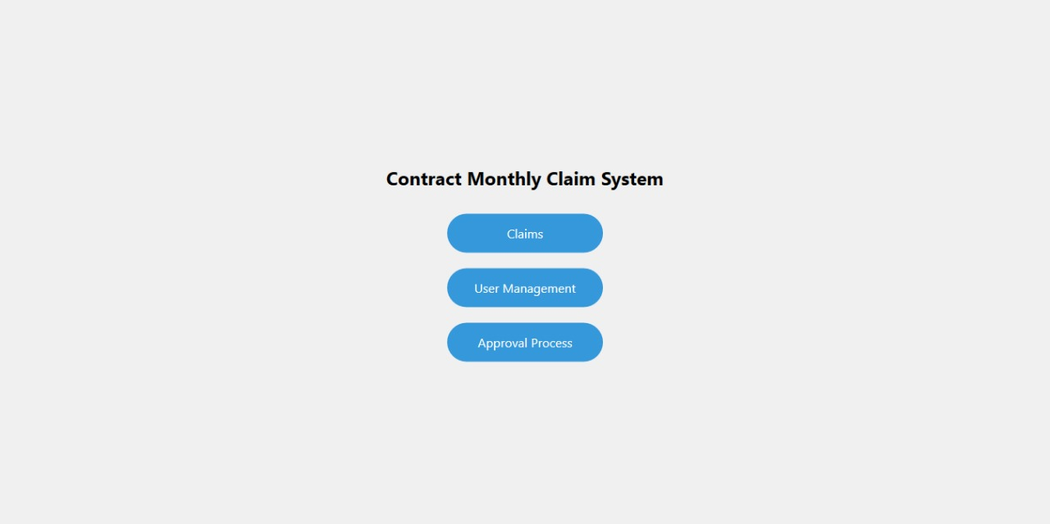
Contract Monthly Claim System (CMCS) Presentation

Slide 2
Agenda 1. System Overview 2. Technical Architecture 3. Key Features & Automation 4. Security & Performance 5. Benefits & Future Enhancements

Slide 3
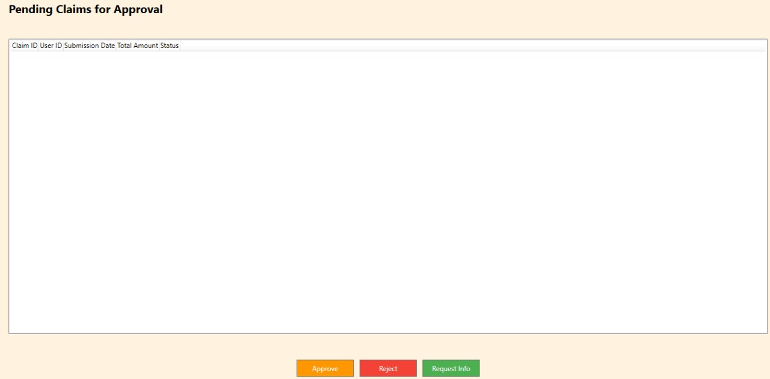
1. System Overview Purpose
Streamlined monthly claim processing for independent contractor lecturers
Automated workflow from submission to approval
Integrated document management system
Real-time status tracking
Target Users
Lecturers
Programme Coordinators
Academic Managers
HR Personnel

Slide 4
2. Technical Architecture Technology Stack
Frontend: ASP.NET Core MVC, jQuery, Bootstrap
Backend: C# (.NET Core)
Database: Entity Framework Core
Authentication: ASP.NET Identity
Reporting: Crystal Reports / SQL Server Reporting Services

Slide 5
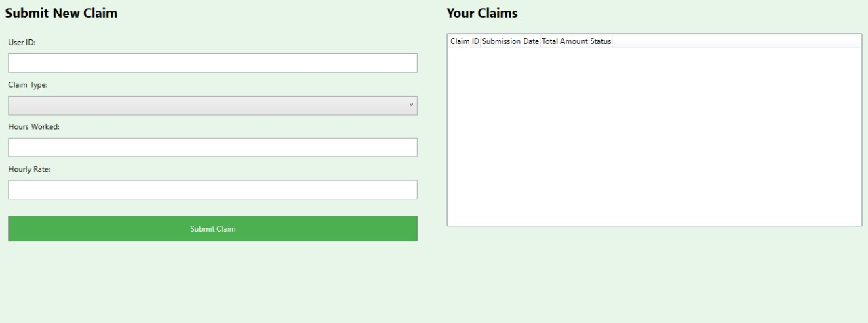
3. Key Features & Automation Lecturer Portal
One-click claim submission
Automated calculation of payments
Document upload with validation
Real-time status tracking Management Dashboard
Automated claim verification
Batch processing capabilities
Custom report generation
Performance analytics Workflow Automation
Smart routing of claims
Automated email notifications
Status updates
Exception handling

Slide 6
4. Security & Performance Security Features
Role-based access control
Data encryption
Secure file storage
Audit logging Performance Optimizations
Caching strategy
Asynchronous processing
Database optimization
Load balancing support

Slide 7
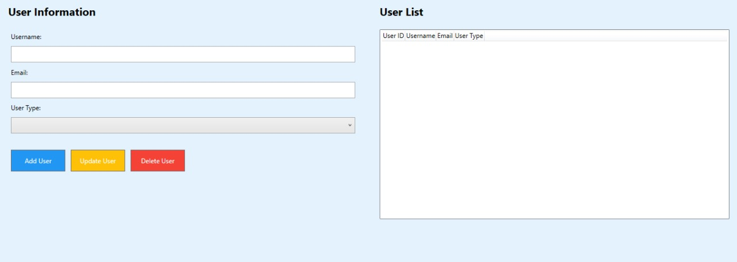
5. Benefits & Future Enhancements Current Benefits
80% reduction in processing time
Improved accuracy
Better user experience
Real-time tracking
Paperless workflow Future Enhancements
Mobile application
Advanced analytics
API integration options
Machine learning for anomaly detection

